Slide 1
05 | Neural Networks
Cynthia Rudin | MIT Sloan School of Management

Slide 2
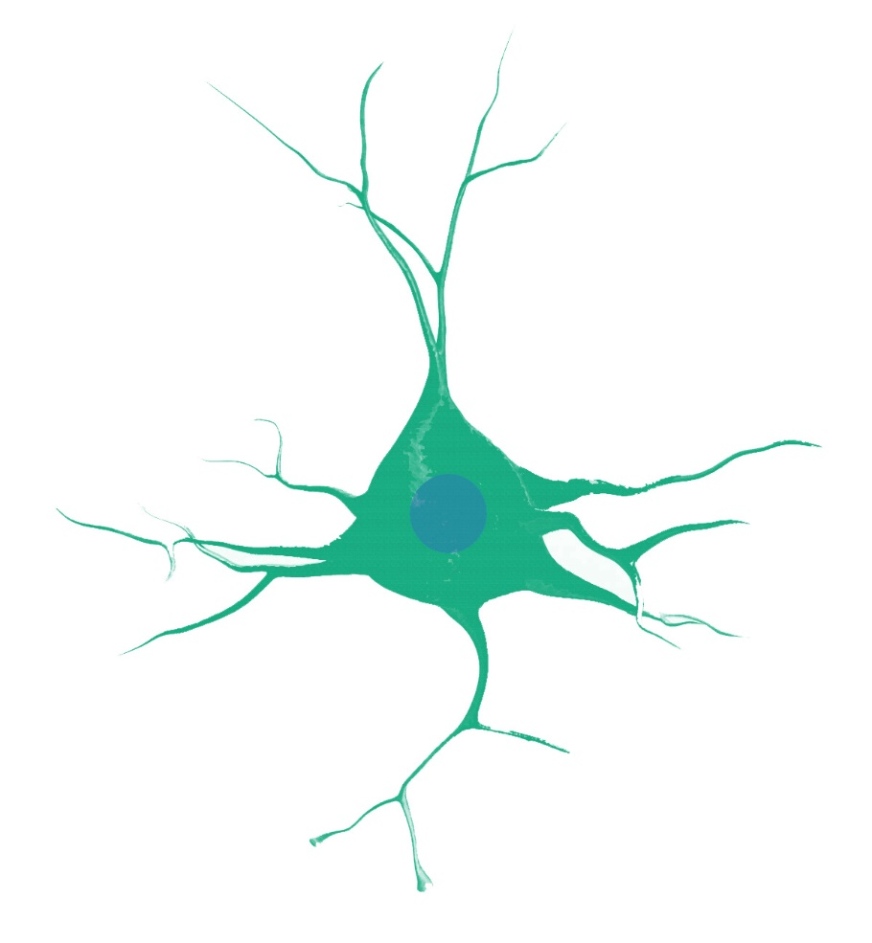
Neurons
10¹¹ neurons in a brain, 10¹⁴ synapses (connections).
Signals are electrical potential spikes that travel through the network.
(Credit: Adapted from Russell and Norvig)
Notes:
An artificial NN is totally different from a real NN. The order of magnitudes are totally different. Brains are much much bigger. The spikes are totally different. ANN’s calculate like calculators, we don’t. It’s just totally different. They were just inspired by brains. In any case, they are becoming extremely popular for computer vision in particular because they can handle really challenging nonlinearities that other methods have difficulty with. If you give them tons and tons of data, they can do things that other methods can’t.

Slide 3
McCulloch-Pitts “Neuron”
“me”
Input
function
Output
Activation Function
Notes:
This is “me” I’m a neuron. I called it “me”. And me sees as input, all of the outputs of the other neurons feeding into it… weighted by their connectivity. So what does me do with all these inputs? It adds them all up. So I’m going to put a little summation there, but what it actually means is this, where it adds up all the signals coming in, weighted by the strength of the connection. Then what. That sum feeds into an activation function, which is something that usually goes between 0 and 1, and is supposed to look like a threshold function. As you know now, these functions can do all kinds of logical computations, ands and ors and whatnot. So there’s the activation function of the sum, which I am going to call “net” later on. The value of the activation function is actually the output of that neuron, so I’ll call it o of me. And then o of me feeds into all the neurons that it connects to, weighted by the connection strength.
ttp://aima.eecs.berkeley.edu/slides-pdf/chapter20b.pdf

Slide 4
McCulloch-Pitts “Neuron”
Step Function
Input
function
Output
Activation Function
Notes:
The step function is a threshold. If you get enough electrical input from the other neurons, you fire. You can’t take
http://aima.eecs.berkeley.edu/slides-pdf/chapter20b.pdf

Slide 5
McCulloch-Pitts “Neuron”
Input
function
Output
Activation Function
Notes:
So we’ll stick to this one.
http://aima.eecs.berkeley.edu/slides-pdf/chapter20b.pdf

Slide 6
McCulloch-Pitts “Neuron”
Step Function
1
0
o₁ | o₂ | output
0
Notes:
http://aima.eecs.berkeley.edu/slides-pdf/chapter20b.pdf

Slide 7
McCulloch-Pitts “Neuron”
Step Function
1
0
o₁ | o₂ | output
0 | 0
0
0+0-1.5 = -1.5
Notes:
http://aima.eecs.berkeley.edu/slides-pdf/chapter20b.pdf

Slide 8
McCulloch-Pitts “Neuron”
Step Function
1
0
o₁ | o₂ | output
0 | 0 | 0
0
0+0-1.5 = -1.5
Notes:
http://aima.eecs.berkeley.edu/slides-pdf/chapter20b.pdf

Slide 9
McCulloch-Pitts “Neuron”
Step Function
1
0
o₁ | o₂ | output
0 | 0 | 0
1 | 0 | 0
0
1+0-1.5 = -0.5
Notes:
http://aima.eecs.berkeley.edu/slides-pdf/chapter20b.pdf

Slide 10
McCulloch-Pitts “Neuron”
Step Function
1
0
o₁ | o₂ | output
0 | 0 | 0
1 | 0 | 0
0 | 1 | 0
0
0+1-1.5 = -0.5
Notes:
http://aima.eecs.berkeley.edu/slides-pdf/chapter20b.pdf

Slide 11
McCulloch-Pitts “Neuron”
Step Function
1
0
o₁ | o₂ | output
0 | 0 | 0
1 | 0 | 0
0 | 1 | 0
1 | 1
0
1+1-1.5 = 0.5
Notes:
http://aima.eecs.berkeley.edu/slides-pdf/chapter20b.pdf

Slide 12
McCulloch-Pitts “Neuron”
Step Function
1
0
o₁ | o₂ | output
0 | 0 | 0
1 | 0 | 0
0 | 1 | 0
1 | 1 | 1
0
1+1-1.5 = 0.5
Notes:
http://aima.eecs.berkeley.edu/slides-pdf/chapter20b.pdf

Slide 13
McCulloch-Pitts “Neuron”
Step Function
1
0
o₁ | o₂ | output
0 | 0 | 0
1 | 0 | 0
0 | 1 | 0
1 | 1 | 1
0
This neuron computes the function “and.”
There are “or” and “not” neurons too.
Notes:
So in other words *click*. It’s nice to know we can compute some logic. That’s kind of fun. *click* So actually if you put a bunch of these neurons together, you can model all kinds of interesting logical statements!
http://aima.eecs.berkeley.edu/slides-pdf/chapter20b.pdf

Slide 14
McCulloch-Pitts “Neuron”
“Sigmoid”
Activation Function
Notes:
Now as I mentioned, we’re not going to use a strict threshold, we’ll use a soft one because it’s differentiable, and that function is the same sigmoid that we used in logistic regression. If you remember the story, it’s the one that was invented when they thought human populations would saturate a country. Anyway, here’s that sigmoid function for you.
http://aima.eecs.berkeley.edu/slides-pdf/chapter20b.pdf

Slide 15
Single Layer
Error on one observation

Slide 16
Single Layer
Error on one observation
In a brain, the synapses strengthen and weaken in order to learn.
Say the same thing happens here.
How should we set the weights in order to learn (reduce the error)?
Minimize E with respect to the weights.
Notes:
We have all the o’s and w’s computed, we can do that

Slide 17
Backpropagation
An algorithm that trains the weights of a neural network
Requires us to propagate information backwards through the network, then forwards, then backwards, then forwards, etc.
Propagate backwards = chain rule from calculus.

Slide 18
Single Layer
Error on one observation

Slide 19
Single Layer
Error on one observation

Slide 20
Single Layer
Error on one observation

Slide 21
Single Layer
Error on one observation

Slide 22
Single Layer
Error on one observation

Slide 23
Single Layer

Slide 24
Single Layer

Slide 25
Single Layer

Slide 26
Single Layer
Error on one observation

Slide 29
We will need this later – it depends only on node 100

Slide 30
Backpropagation
Go one layer deeper.

Slide 41
Backpropagation
Go even one layer deeper.
Third time is a charm.

Slide 42
80’s
90’s

Slide 44
80’s
90’s

Slide 46
80’s
90’s

Slide 47
90’s

Slide 48
90’s

Slide 49
99
98
97

Slide 50
99
98
97

Slide 53
’s
The L are forward. We must have already computed all the ‘s ahead of us to compute this.

Slide 54
o₁

Slide 55
o₁

Slide 56
o₁

Slide 57
o₁

Slide 58
o₁

Slide 59
o₁

Slide 60
Backpropagation
Now we know how to compute for all of the
Let’s do gradient descent.
α is between 0 and 1. Called the “learning rate”.
Now we know how to propagate errors back through the network.
Remember how to go forward?
Notes:
In standard backprop, too low a learning rate makes the network learn very slowly. Too high a learning rate makes the weights and objective function diverge, so there is no learning at all. You could set it to a half. In reality there are algorithms that adjust this thing dynamically, but in case, hopefully you get the idea, which is that the weight changes depending on how steep the error gradient is at that point.
Cool, so once you do that,

Slide 61
o₁

Slide 62
o₁

Slide 63
o₁

Slide 64
o₁

Slide 65
04 | Support Vector Machines
Cynthia Rudin | MIT Sloan School of Management

Slide 66
Looking at Margins
−
−
+
+
+
+
+
−
+
−
−
Notes:
SVMs started by addressing the question of what decision boundary to pick when all the points are correctly classified. This decision boundary looks pretty good right there. But how did I know not to choose this one?

Slide 67
Looking at Margins
−
−
+
+
+
+
+
−
+
−
−
Notes:
Or this one?

Slide 68
Looking at Margins
−
−
+
+
+
+
+
−
+
−
−
Notes:
Those all look equally plausible, right?

Slide 69
Looking at Margins
−
−
+
+
+
+
+
−
+
−
−
Notes:
What about this one… This one doesn’t seem like a particularly good idea/ Because the line is so close to the points that it might not generalize well for new points. Even though all the training points are classified correctly, maybe the test points won’t like this decision boundary.

Slide 70
Looking at Margins
Want all points far from the decision boundary.
Want “minimum margin” to be large.
−
−
+
+
+
+
+
−
+
−
−
Notes:
This is a way of just looking at the margins which are y times f. So what do we do?

Slide 71
Looking at Margins
Want all points far from the decision boundary.
Want “minimum margin” to be large.
Min margin is distance to nearest training observation
−
−
+
+
+
+
+
−
+
−
−
Notes:
This is a way of just looking at the margins which are y times f. So what do we do?

Slide 72
Looking at Margins
Want all points far from the decision boundary.
Want “minimum margin” to be large.
Min margin is distance to nearest training observation
−
−
+
+
+
+
+
−
Margins
+
−
−
Notes:
Let’s look at it from the margins perspective, which I showed you earlier. This is a way of just looking at the margins which are y times f.
And just so you didn’t forget the minimum margin is the smallest value of y times f(x).

Slide 73
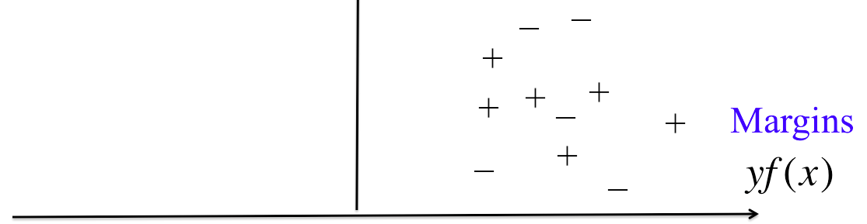
Looking at Margins
Want all points far from the decision boundary.
Want “minimum margin” to be large.
Min margin is distance to nearest training observation
Notes:
This is a way of just looking at the margins which are y times f.

Slide 74
Looking at Margins
Want all points far from the decision boundary.
Want “minimum margin” to be large.
Min margin is distance to nearest training observation
Notes:
This is a way of just looking at the margins which are y times f.

Slide 75
SVM Step 1
This has scaling issues. The answer is infinity.
Notes:
This has an issue because gamma and f don’t actually mean anything, there’s a scaling issue that we need to deal with. If I just multiply f by a million or some other big number, then all of a sudden, gamma is a million times bigger.

Slide 76
SVM Step 1
Force to be relative to the size of .
Now γ is meaningful, but it’s still arbitrary which f I pick.
2f and f are equally good. Need to choose scaling.
Now it’s fixed
Notes:
So however big f gets, gamma is going to scale inversely with that. Haha, let’s try that one.
So I have to choose something. I will choose the right hand side of this equation to be 1.

Slide 77
SVM Step 1
Notes:
So however big f gets, gamma is going to scale inversely with that. Haha, let’s try that one.
So I have to choose something. I will choose the right hand side of this equation to be 1.

Slide 78
SVM Step 1
Notes:
So however big f gets, gamma is going to scale inversely with that. Haha, let’s try that one.
So I have to choose something. I will choose the right hand side of this equation to be 1.

Slide 79
SVM Step 1
−
−
+
+
+
+
+
−
+
−
−
Notes:
So however big f gets, gamma is going to scale inversely with that. Haha, let’s try that one.
So I have to choose something. I will choose the right hand side of this equation to be 1.

Slide 80
SVM Step 1
Notes:
So however big f gets, gamma is going to scale inversely with that. Haha, let’s try that one.
So I have to choose something. I will choose the right hand side of this equation to be 1.

Slide 81

SVM Step 1
Notes:
So however big f gets, gamma is going to scale inversely with that. Haha, let’s try that one.
So I have to choose something. I will choose the right hand side of this equation to be 1.

Slide 82
SVM Step 1
Notes:
So however big f gets, gamma is going to scale inversely with that. Haha, let’s try that one.
So I have to choose something. I will choose the right hand side of this equation to be 1.

Slide 83
SVM Step 2
Notes:
So however big f gets, gamma is going to scale inversely with that. Haha, let’s try that one.
So I have to choose something. I will choose the right hand side of this equation to be 1.

Slide 84
SVM Step 2

Slide 85
SVM Step 2

Slide 86
SVM Step 2

Slide 87
SVM Step 3
This optimization problem is solved through standard techniques in convex optimization (Lagrange multipliers, KKT conditions)

Slide 88
SVM Step 3
−
−
+
Support Vectors
+
+
+
+
−
+
−
−

Slide 89
The Nonseparable Case

Slide 90
The Nonseparable Case
+
−
−
−
+
+
+
+
+
−
−
+
−
+
+
−

Slide 91
The Nonseparable Case
Separable Case SVM
+
−
−
−
+
+
+
+
+
−
−
+
−
+
+
−
Notes:
This has got to change to accommodate the points that are not classified correctly.

Slide 92
The Nonseparable Case
+
−
−
−
+
+
+
+
+
−
−
+
−
+
+
−
Notes:
Let’s give you the geometric picture here. The decision boundary is this line right here. F being positive is here, and f being negative is here. The red points are all misclassified. Now what I’m going to do is something you might not be expecting, which is that I’m going to move all the correctly classified points across the decision boundary to the left, and I’m going to map all the misclassified points to the right. *click* Ok, glad I did that, now I have the ones we got correct on the left and the ones we got wrong on the right. So the labels on this plots are wrong. We don’t have f<0 on the left and f>0 on the right. We have something like this. *click*. So on the left, either f is positive and y is also positive, so yf is positive, or we have y negative and f negative, so yf is again… positive. And on the right we have cases where the sign of f is different than y. And the ones I suffer a penalty for are the ones on the right.

Slide 93
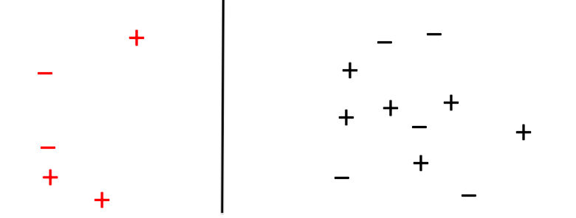
Notes:
Ok so let’s keep this image in mind here.
----
Why are those equal?
Think about it. There are only a few possibilities. If y is positive and f is positive, then we don’t make a mistake, and the top is 0. yf is positive, not negative, so the bottom is 0.
If y and f are both negative, then we don’t make a mistake, the top is 0 and and yf is positive again.
If y is positive and f is negative, then we make a mistake, we lose a point up here, and we also lose a point down here because y times f is negative.
Same thing if y is negative and f is positive.
So these logical expressions are equal to each other.

Slide 94
“sort of correct”
“very correct”
“sort of wrong”
“very wrong”
Notes:
I’m just going to write this function another way, which is like this. So we lose one point if yf is less than 0, and otherwise we lose no points. This is the classic 0-1 loss, just tells you whether your classifier is right or wrong. This is called a loss function. There are other loss functions too. This one is nice but it’s problematic because it’s not smooth, and we have issues with things that are not smooth in machine learning. Let’s try some more loss functions. While we’re doing this…
----
Why are those equal?
Think about it. There are only a few possibilities. If y is positive and f is positive, then we don’t make a mistake, and the top is 0. yf is positive, not negative, so the bottom is 0.
If y and f are both negative, then we don’t make a mistake, the top is 0 and and yf is positive again.
If y is positive and f is negative, then we make a mistake, we lose a point up here, and we also lose a point down here because y times f is negative.
Same thing if y is negative and f is positive.
So these logical expressions are equal to each other.

Slide 95
“sort of correct”
“very correct”
“sort of wrong”
“very wrong”

Slide 96
The Nonseparable Case
Separable Case SVM
Notes:
This has got to change to accommodate the points that are not classified correctly.

Slide 97
The Nonseparable Case
Separable Case SVM
Notes:
This has got to change to accommodate the points that are not classified correctly.

Slide 98
The Nonseparable Case
Non-separable Case SVM
Notes:
This has got to change to accommodate the points that are not classified correctly.

Slide 99
The Nonseparable Case
Non-separable Case SVM
Notes:
This has got to change to accommodate the points that are not classified correctly.

Slide 100
The Nonseparable Case
Non-separable Case SVM
The minimization problem is solved using sequential minimal optimization (SMO), where two variables are adjusted at a time.
Notes:
This has got to change to accommodate the points that are not classified correctly.

Slide 101
Kernels for SVM
The “kernel trick” allows the SVM to map all points to a high dimensional space where points are more easily separated.
Notes:
But the picture is a little misleading since you never actually see the function phi.

Slide 102
Kernels for SVM

Slide 103
Kernels for SVM
Zillow estimate
House’s list price
Avg price in neighborhood
Length of time on market

Slide 104
Kernels for SVM
House’s list price
Avg price in neighborhood

Slide 105
Kernels for SVM
Notes:
Inner product is simply just multiplying the first components together, multiplying the second components together and adding them all up. Inner products are a way to think about distance in a space. So here, we’re thinking about distances in a 2d space.

Slide 106
Kernels for SVM
Notes:
What would happen if we play this game where we map x to a new space. And then we’ll compute the inner product in that space instead.

Slide 107
Kernels for SVM

Slide 108
Kernels for SVM
(2d ➔3d)

Slide 109
Kernels for SVM
(2d ➔3d)

Slide 110
Kernels for SVM
One way to map to a high dimensional space with SVM:
Decide on
Anywhere in the optimization problem where there is an x_{i}, replace it with
Solve the new optimization problem.

Slide 111
Kernels for SVM
One way to map to a high dimensional space with SVM:
Decide on
Anywhere in the optimization problem where there is an x_{i}, replace it with
Solve the new optimization problem.

Slide 112
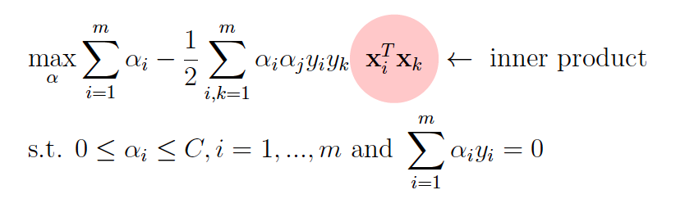
Kernels for SVM
There is a special property of the SVM optimization problem:
It only depends on x_{i} through inner products.
The only terms involving x_{i} are Inner Product(x_{i} x_{k}).
You will never see x_{i} by itself or in other ways.
SVM Dual Form:

Slide 113
Kernels for SVM
There is a special property of the SVM optimization problem:
It only depends on x_{i} through inner products.
The only terms involving x_{i} are Inner Product(x_{i} x_{k}).
You will never see x_{i} by itself or in other ways.
Wherever the formulation says to compute Inner Product(x_{i} x_{k}), you replace it with
The cool thing is…
You never need to compute ϕ(x_{i}) at all.
Just replace Inner Product(x_{i} x_{k}) with Inner Product(ϕ(x_{i}), ϕ(x_{k}))

Slide 114
Kernels for SVM
Inner Product(x_{i} x_{k}) ➔Inner Product(ϕ(x_{i}), ϕ(x_{k}))
= K(x_{i} x_{k})
This is the magic of SVM.
Notes:
It doesn’t matter if the map phi is infinite dimensional, it doesn’t matter if it’s impossible to calculate. As long as you can calculate the kernel between two points, you can run the optimization formula. So with one click, you can tell the SVM which kernel it should use for that particular calculation, and it just calculates kernels where it’s supposed to calculate regular inner products and whoosh you’re now in a new space. Pretty cool, huh.

Slide 115
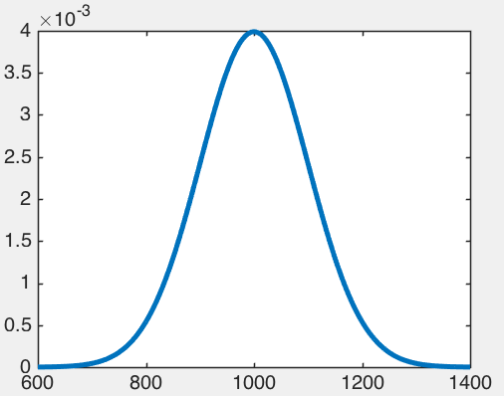
Kernels for SVM
Inner Product(x_{i} x_{k}) ➔Inner Product(ϕ(x_{i}), ϕ(x_{k}))
= K(x_{i} x_{k})
This is the magic of SVM.
Notes:
One particularly useful kernel is the gaussian kernel. This is a case where I can’t exactly calculate phi on my computer because it’s a whole function and thus infinite dimensional. You’d need an infinite number of values to write out the whole function so of course you can’t do that in a computer. But you can actually write down the inner product.

Slide 116
Kernels for SVM
Inner Product(x_{i} x_{k}) ➔Inner Product(ϕ(x_{i}), ϕ(x_{k}))
= K(x_{i} x_{k})
Notes:
One particularly useful kernel is the gaussian kernel. This is a case where I can’t exactly calculate phi on my computer because it’s a whole function and thus infinite dimensional. You’d need an infinite number of values to write out the whole function so of course you can’t do that in a computer. But you can actually write down the inner product.

Slide 117
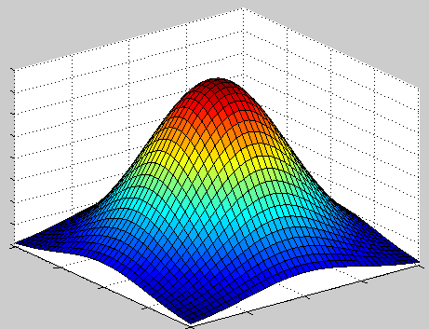
Gaussian / Radial Basis Function (RBF) Kernels
Notes:
This is a weighted sum of bumps called K, centered at xi. This is a bump, think of it as being centered at xi.

Slide 118
Gaussian / Radial Basis Function (RBF) Kernels
Notes:
There are lot of training observations, so we have to add a lot of bumps together.

Slide 119
Gaussian / Radial Basis Function (RBF) Kernels
Notes:
Some of the bumps could be right side up and some of them could be upside down, depending on what the alphas are.

Slide 120
Gaussian / Radial Basis Function (RBF) Kernels
Notes:
Some of the bumps could be right side up and some of them could be upside down, depending on what the alphas are.

Slide 121
Gaussian / Radial Basis Function (RBF) Kernels
Notes:
Some of the bumps could be right side up and some of them could be upside down, depending on what the alphas are.

Slide 122
+
+
+
+
−
−
+
+
+
−
−
+
−

Slide 123
+
+
+
−
+
−
+
+
−
−
+
−
+
Notes:
You have to be careful not to choose the bandwidth parameter to be too small. Otherwise it’ll overfit.

Slide 124
+
+
+
−
+
−
+
+
−
−
+
−
+
Notes:
It’ll sort of snake its way around to try to make things separable and it’ll overfit.

Slide 125
Common Kernels
Linear (which is the same as “no kernel”)
Polynomial (like the example I showed you at the beginning), where you choose the degree (too large will over fit).
Gaussian (like the example I just showed you) where you choose the bandwidth (too small will over fit).

Slide 126
Advantages of SVM
Easily handles nonlinearities
Based on quadratic programming, has specialized solvers
Anyone who runs it will (theoretically) get the same answer
Can easily handle imbalanced data by reweighting the points.
Disadvantages of SVM
Sometimes the solvers are slow
Doesn’t naturally scale to huge datasets
Performance not that reliable in practice
SVM models are totally uninterpretable
Note
Choice of kernel can be tricky.
Notes:
SVM is theoretically very beautiful.
- Because of the kernel trick. All the nonlinear stuff is pre-computed when you compute the kernels. So even though you’re solving a regular mathematical problem to get a linear model, you can get something that’s highly nonlinear.
- QP’s are not that hard, they are harder than linear programs to solve, but we have these specialized solvers that can do it.
These algorithms don’t rely on randomness the way that other algorithms do. If you and I send the same dataset into an svm and tell it to use the same kernel, the answer should be the same and should not rely on exactly which specialized solver gets used. That’s because of the nature of the optimization problem.
Dis:
Right now, SVM is not my first choice of things to recommend to people. For the implementations that my group has been using at least, SVM solvers can be on the slow side. And sometimes even after tuning the kernel parameters, the performance is lousy. Most of the time it’s not lousy but sometimes it is. And I can’t tell you in advance when that’s going to happen. When you’re thinking about high dimensional datasets, it’s not clear really what’s going on.

